Slide 1
Lifting your Data Skills to the Cloud
Taiob Ali
He/Him/His
Database Solutions Manager
GMO LLC
Notes:
Thanks to the organizers, sponsors, and volunteers. Thanks to all the attendees, especially those of you who are here. This is part of the six-part learning pathway. Add those to your calendar and attend the other five sessions.
Before we start
How many of you do not have any resources in cloud
How many of you are exploring and preparing to starting deploying resources in cloud
How many of you are well into your cloud journey and comfortable with your skill

Slide 2



Taiob
Ali
He/Him/His
Database Solutions Manager
I am a Microsoft Data Platform MVP, For 17 years, I have worked with the Microsoft Data Platform and MongoDB, both on-premises and cloud.
I currently work at "GMO LLC" as a Database Solutions Manager, focusing on cloud migration, automation, improving, and streamlining operational workflow.
GMO LLC
@sqlworldwide
Taiob@sqlworldwide.com
www.sqlworldwide.com
Notes:
If you need to get in touch with me after the summit, please use these contacts. I have old-fashioned cards; take one if you prefer.

Slide 3

Notes:
Give me honest feedback, please. Do not tell me just you did not like something, please tell me why.
I have been married for over 25 years; I have an awesome wife and three lovely children, so I am ok with raw feedback.

Slide 4

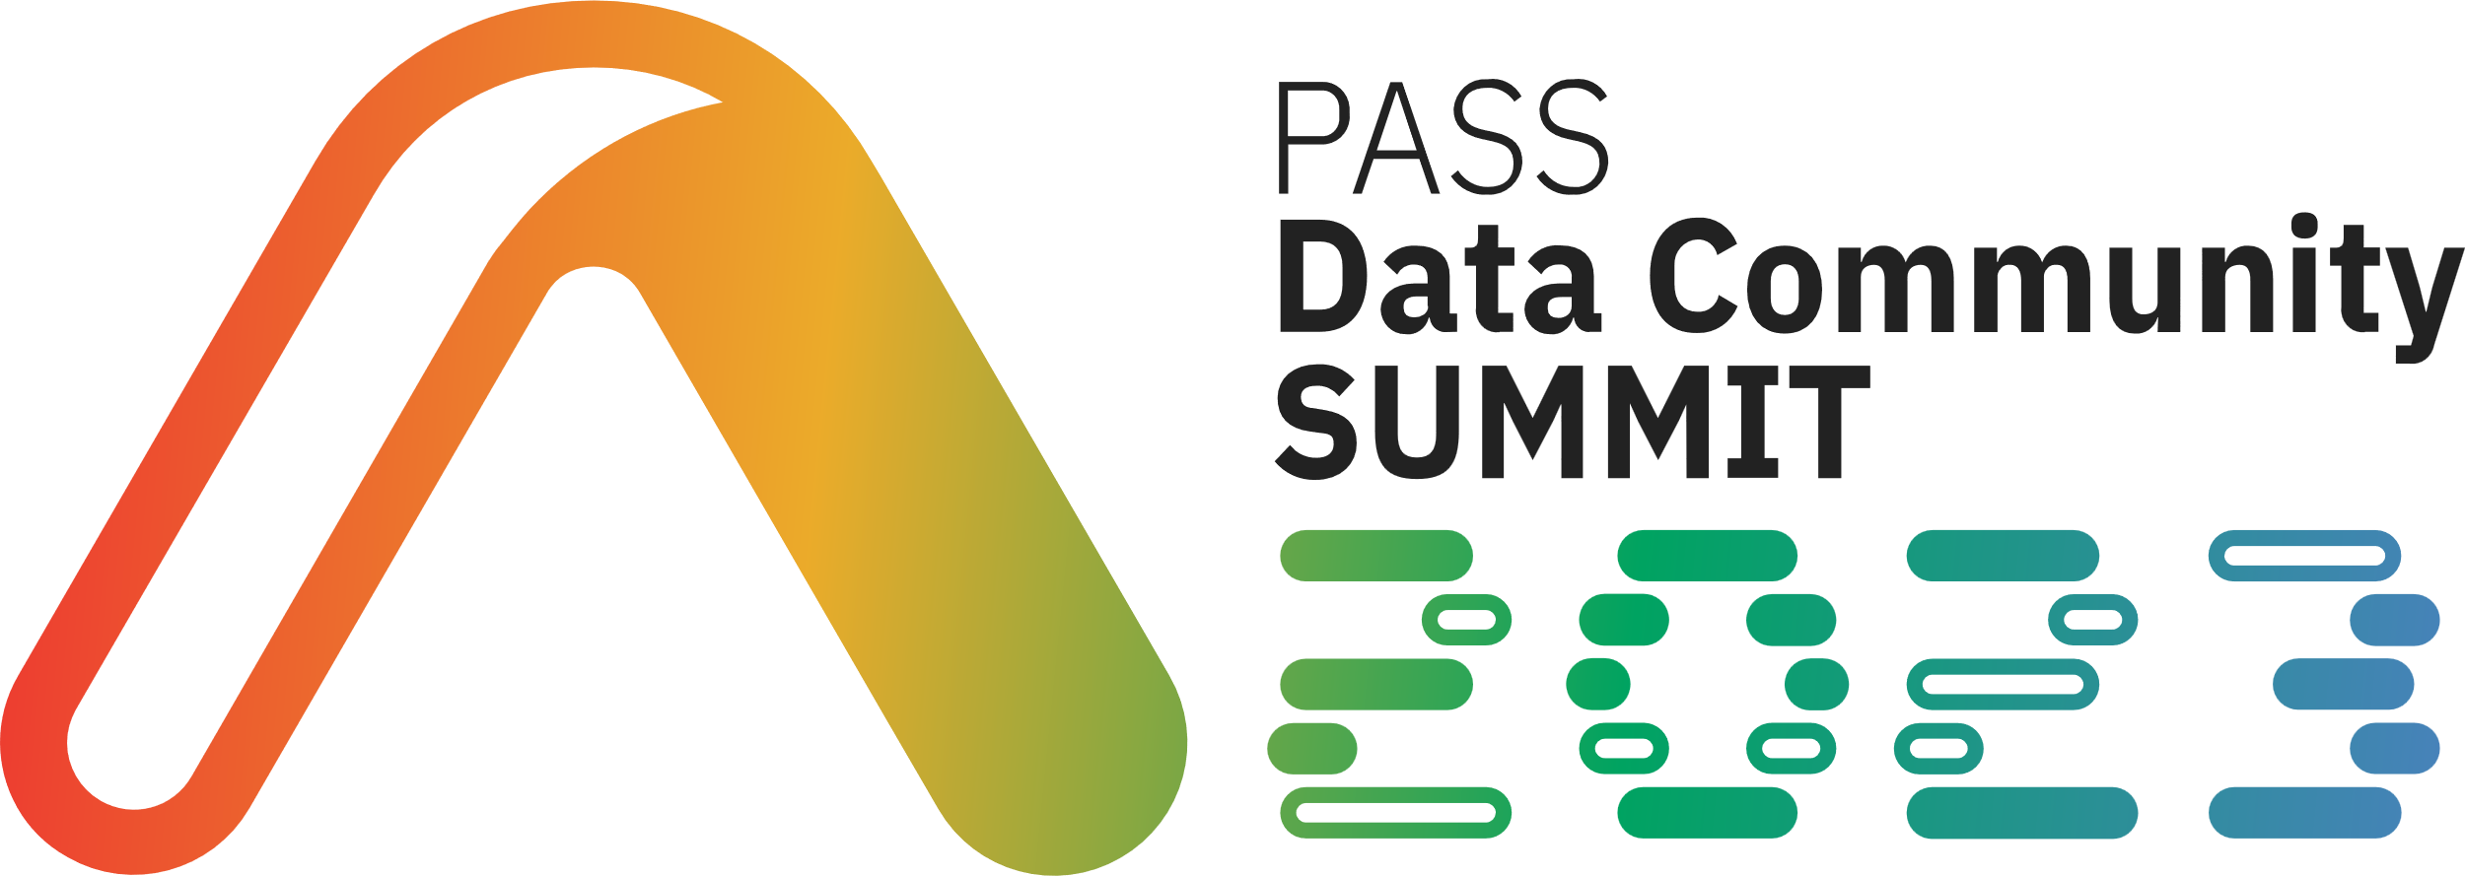
Topics Covered
Provisioning
Migration
Monitoring - Performance Tuning
Security
Alerting
Network
Cost Control
Notes:
I will briefly touch on these topics. If you want to get details, attend other sessions.
I understand there are many cloud providers, but we will stick to Microsoft’s Azure platform
I have good news for you.
Everything you learned by administering on-premises SQL Server/databases is valid in the Cloud. You do not have to erase anything from your brain.
Some things you need to change the way you think
Example: Security for Azure SQL Databases; you want to contain security within the database and not use login/user mapping.
There are some things you need to learn brand-new, and we will talk about many of these today.
There are many links for you to go to for details I added in the slides as we will be just talking about overview.

Slide 5
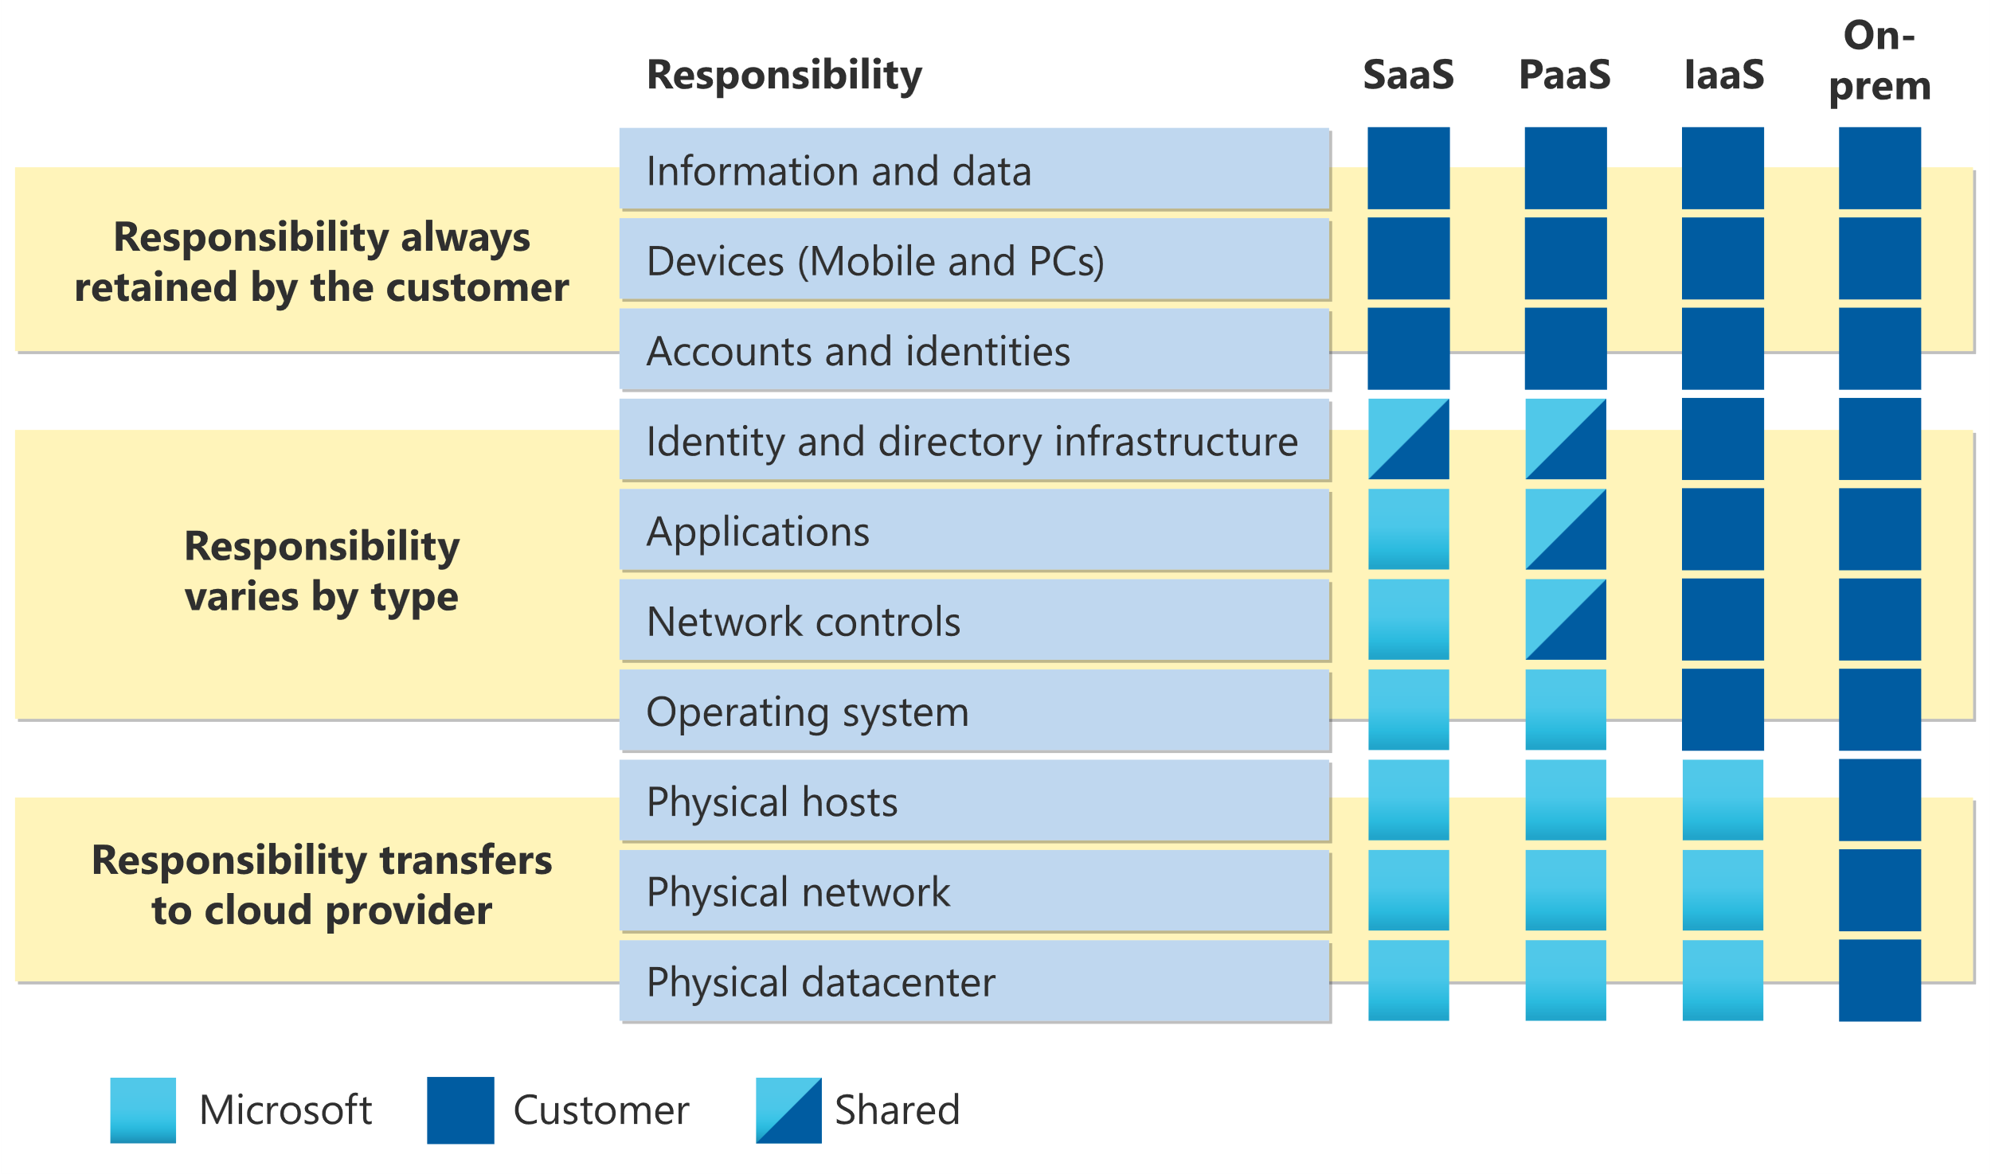
https://learn.microsoft.com/en-us/training/modules/describe-cloud-service-types/2-describe-infrastructure-service
Notes:
This is key for understanding who is responsible for what component once you move/deploy resources in the cloud.
Spend some time before you embark on your cloud journey.
Ensure handing over responsibility to the cloud provider aligns with your company/client’s business and security goals.
This should not be a decision taken by you alone. Bring all parties together and decide based on your company/client’s policy.

Slide 6




Provisioning
Region (Availability Zones)
Management Group
Subscription
Resource Group
Notes:
On-premises, we only considered the data center and geographical location.
Now, we need to think a little more:
Region (If I need Availability Zones, does this region have this available)
What is an availability zone?
Azure availability zones are physically and logically separated datacenters with their own independent power source, network, and cooling. Connected with an extremely low-latency network, they become a building block to delivering high availability applications.
Management Group
Subscription
Resource Group
A lot depends on your company's overall network design and billing setup.

Slide 7
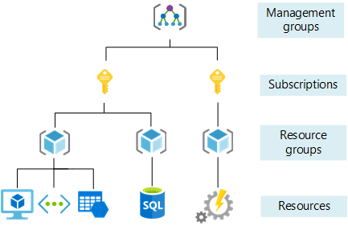
Provisioning
https://www.javatpoint.com/what-is-microsoft-azure-subscription
Notes:
This is a hierarchy of the four things I talked about in the previous slide.

Slide 8




Provisioning
SQL on Azure VM
Azure SQL Managed Instance
Azure SQL Database
Azure SQL Edge
Notes:
While provisioning a new SQL Server or upgrading On-premises, you mainly consider SQL Server and Windows versions and hardware.
Now, in Azure, you need to consider many options; let’s discuss this.
First, you decide what kind of resource you want to provision. Within each of these, you have more things to consider
Let’s go over two of these as an example in the interest of time
SQL on Azure VM
Azure SQL Database PaaS model
One advantage we have in Azure is:
You can scale up and down on demand to cater to peek requirement and control cost
Compare to On-Premises once you buy a hardware, it is racked and ready to use you are stuck for years

Slide 9
Provisioning
Control over OS & SQL Version
Automated Backup
SSAS, SSRS, SSIS availability
IaaS Extension
Security updates
Scale up and Down, Shut down and only pay for storage
Can use all HA/DR solution as on premises
Deployment
Marketplace
Install your own
Lift and Shift with Azure Migrate
SQL on Azure VM
Notes:
While provisioning SQL on Azure VM, you need (or you can) to consider all of these

Slide 10
Provisioning
Need to know
Scale up and down/Auto Pause
Fully managed and always on the latest version of SQL
Purchase Model
Compute options
Hardware choice
Reserved data storage
Point In Time and Long-Term backup retention
Built in HA/DR – Is that enough for you?
Understand log rate limits
Azure SQL Database
Notes:
Take an example of Azure SQL Database:
No more major versions, Compat level only
Purchase Model DTU vs vCore
Under vCore:
Service tier
Compute
Hardware configuration
Reserved database storage
Actual backup storage
Know about serverless/auto pause/elastic pool
Know your backup options for PIT and LTR backup
You do not control backup times.
Retention is per database, and you need to set that up
Built-in HA/DR for certain tiers, but you need to decide if that is enough for you based on the SLA you agreed with your business owners

Slide 11

Migration
SQL Server (upgrade)
Azure SQL Database
Azure SQL Managed Instance
SQL Server on Azure VMs
Azure Synapse Analytics
SQL Server
Notes:
Now you have more options when it comes to options for Migration, as you can see in this slide.
What is still applicable:
On-premises migration tool
Sync system objects
Transaction Replication
Backup Restore
Log shipping
Bulk copy
Import Export Service

Slide 12

Migration
Azure Readiness
Azure Sizing
Azure Cost Estimation
Dependency Analysis
Azure Migrate appliance, deploy on-premises.
Azure Migrate
Notes:
Azure Migrate is your one-stop shop for many Migration scenarios especially when it comes to in scale migration
Unified migration platform: A single portal to start, run, and track your migration to Azure.
Azure Migrate can help you with the following:
On-premises VMware VMs
On-premises Hyper-V VMs
On-premises physical servers or servers hosted on other clouds
Web apps hosted on Windows OS in a VMware environment
The Discovery and assessment tool uses a lightweight Azure Migrate appliance you deploy on-premises.
Then, the tool does the following:
Azure readiness: Assesses whether on-premises servers, SQL Servers and web apps are ready for migration to Azure.
Azure sizing: Estimates the size of Azure VMs/Azure SQL configuration/number of Azure VMware Solution nodes after migration.
Azure cost estimation: Estimates costs for running on-premises servers in Azure.
Dependency analysis: Identifies cross-server dependencies and optimization strategies for moving interdependent servers to Azure. Learn more about Discovery and assessment with dependency analysis.
Azure Data Box – Use Azure Data Box products to move large amounts of offline data to Azure

Slide 13

Migration
Database Migration Service (classic)
Azure Database Migration Service
Azure SQL Migration Extension for Azure Data Studio
Azure Portal
PowerShell
Azure CLI
Older version of DMS (Do not use for SQL Migration)
Azure Database Migration Services
https://learn.microsoft.com/en-us/azure/dms/dms-overview#compare-versions
Notes:
Azure Database Migration Service is a fully managed service designed to enable seamless migrations from multiple database sources to Azure data platforms with minimal downtime (online migrations).
Size does not matter anymore. Data migration was always a challenge for large databases to minimize downtime, which is no longer the case.
SQL Server to Azure SQL Managed Instance Online / Offline
SQL Server to SQL Server on Azure Virtual Machine Online / Offline
SQL Server to Azure SQL Database Offline
This URL will take you to compare the three versions of Azure Database Migration services

Slide 14

Migration
BACPAC
DACPAC
Transactional Replication
Bulk Copy
Azure Data Factory
SQL Data Sync
Other Migration Tools
Notes:
Bacpac: is a Windows file with a .bacpac extension that encapsulates a database's schema and data. You can use BACPAC to both export data from a SQL Server source and import the data into Azure SQL Database. A BACPAC file can be imported to a new SQL database through the Azure portal.
A data-tier application (DAC) is a logical database entity that defines all of the SQL Server objects - such as tables, views, and instance objects, including logins - associated with a user's database. A DAC is a self-contained unit of the entire database model and is portable in an artifact known as a DAC package, or .dacpac

Slide 15
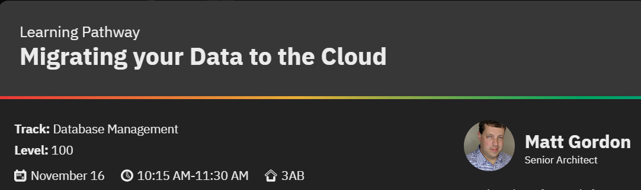

Slide 16
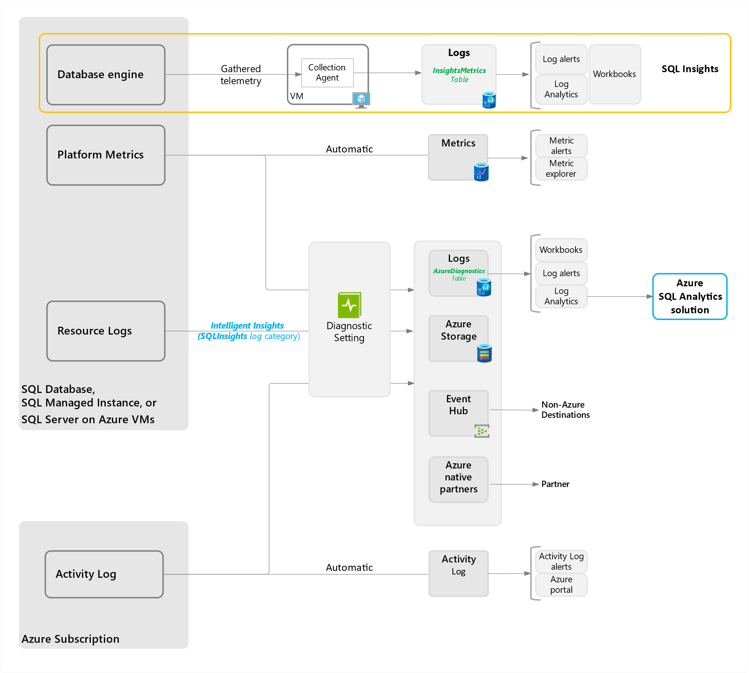
Monitoring - Performance Tuning
Monitoring and diagnostic telemetry
https://learn.microsoft.com/en-us/azure/azure-sql/database/monitor-tune-overview?view=azuresql
Notes:
The diagram details all the database engine, platform metrics, resource logs, and Azure activity logs generated by Azure SQL products, how they are processed, and how they can be surfaced for analysis.
Some of these are automatically collected without you doing anything; Some you have to set for collection.
For example, standard metrics are collected automatically
Query store which provides ‘query performance insight’ is automatic (not available in MI)
Diagnostic settings you will need to turn on and choose what you want to be collected and destination repo
I am trying to think of something redundant that you know for the on-premises SQL Server. And I cannot think of anything.
I purposely combined Monitoring and performance tuning. You do not know what and where to start tuning without adequate monitoring.
You will need to know that there are some DMV and DMF differences between on-premises and Azure SQL
For example: sys.dm_db_resource_stats
Returns CPU, I/O, and memory consumption for a database in Azure SQL Database or an Azure SQL Managed Instance. One row exists for every 15 seconds, even if there is no activity. Historical data is maintained for approximately one hour.
sys.resource_stats catalog view in Azure SQL Database
Returns CPU usage and storage data for a database in Azure SQL Database. The data is collected and aggregated within five-minute intervals. For each user database, there is one row for every five-minute reporting window in which there is a change in resource consumption. The data returned includes CPU usage, storage size change, and database SKU modification. Idle databases with no changes may not have rows for every five-minute interval. Historical data is retained for approximately 14 days.
sys.server_resource_stats -Azure SQL Managed Instance
Returns CPU usage, IO, and storage data for Azure SQL Managed Instance. The data is collected, aggregated and updated within 5 to 10 minutes intervals. There is one row for every 15 seconds reporting. The data returned includes CPU usage, storage size, IO utilization, and SKU. Historical data is retained for approximately 14 days.

Slide 17
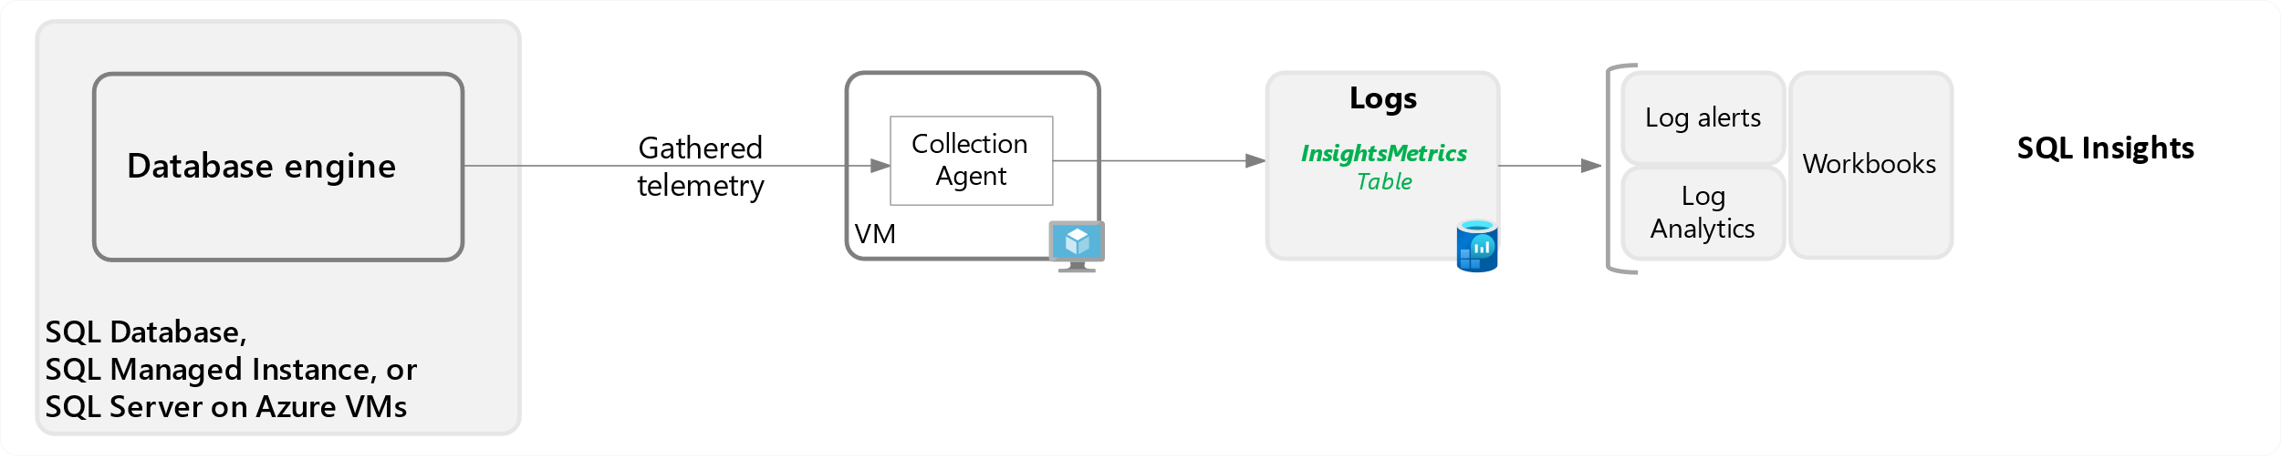
Monitoring – Performance Tuning
SQL Insight (preview)
https://learn.microsoft.com/en-us/azure/azure-sql/database/sql-insights-overview?view=azuresql
Notes:
I took one of the most crucial section from the previous slides and talk about more details.
Diagram details the steps taken by information from the database engine and Azure resource logs, and how they can be surfaced. For a more detailed diagram of Azure SQL logging, see Monitoring and diagnostic telemetry.
Cost money to gather data, store, and rules configured on the data
You can use built-in workbooks
You can delve directly into data using Log Queries (Kusto)
SQL Insights (preview) is a comprehensive solution for monitoring any product in the Azure SQL family.
SQL Insights uses dynamic management views to expose the data you need to monitor health, diagnose problems, and tune performance.
SQL Insights performs all monitoring remotely.
Monitoring agents on dedicated virtual machines connect to your SQL resources and remotely gather data.
The gathered data is stored in Azure Monitor Logs to enable easy aggregation, filtering, and trend analysis.
You can view the collected data from the SQL Insights workbook template, or you can delve directly into the data by using log queries.
I highly recommend you start learning Kusto Query language
Alerting will be built on top of SQL insight

Slide 18

Monitoring – Performance Tuning
Metrics
Performance Overview
Performance Recommendations
Query Performance Insight
Automatic Tuning
Built into Portal
Notes:
You want to avoid setting alerting/Monitoring from these collections in the portal because you have to repeat the same for each instance. You want to do that from the central collection.
Metrics
Automatically collected for 30 days
Performance Recommendations
Create index
Drop index
Parameterize query recommendations (preview) - one or more queries that are constantly being recompiled but end up with the same query execution plan
Fix schema issues recommendations (preview) – will be deprecated
Query Performance Insight
top by cpu/IO/Log IO
Long-running Queries
Custom query
Automatic Tuning
Server or database scope
Force plan
Create index
Drop index

Slide 19
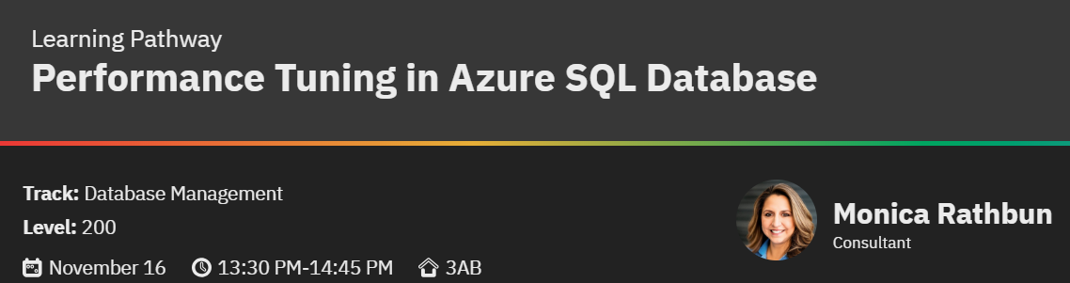

Slide 20
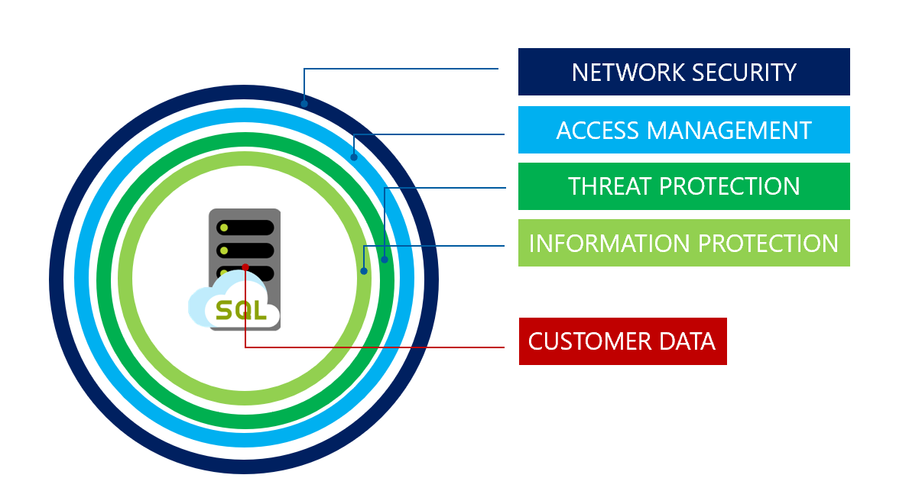
Security
https://learn.microsoft.com/en-us/azure/azure-sql/database/security-overview?view=azuresql
Notes:
Concept of Security does not change but now you are in a shared public space. It is a joint responsibility between the cloud provider and you.
We have more services with real-time monitoring for security threats and anomalies.
Key is to enable, configure, baseline and setup alerts

Slide 21

Security
Network Security
Firewalls
Private Endpoint
Auditing
Access Management
Authentication
Authorization
Access Control
Threat Protection
Threat detection
Information Protection
Data Encryption
Database backup
Physical Security
Database Security
Notes:
How do you implement the four layers of security?
Here I have listed how we achieve of the four layers. We are not going into details of each of these. Some of these are known to you, and some might be new.
For example these are known even on premises:
Firewalls
Authentication
Change the way you think. For PaaS SQL Server is logical, you want to contain user within the database without a server level login.

Slide 22
Security
Azure SQL Auditing
Ledger
Data Discovery & Classification
Defender for Cloud
SQL vulnerability assessment
User-Assigned Managed Identity
Encryption
TDE
Always Encrypted
SQL Advanced Threat Protection
Tools
Notes:
Auditing for Azure SQL Database and Azure Synapse Analytics tracks database events and writes them to an audit log in your Azure storage account, Log Analytics workspace, or Event Hubs.
Helps you maintain regulatory compliance, understand database activity, and gain insight into discrepancies and anomalies that could indicate business concerns or suspected security violations.
Ledger: (Public preview for Azure MI)
The ledger feature provides tamper-evidence capabilities in your database. You can cryptographically attest to other parties, such as auditors or other business parties, that your data hasn't been tampered with.
Enabling the ledger functionality at the database level will make all tables in this database updatable ledger tables.
Need storage account
Data Discovery & Classification combined with Purview Data Loss Prevention
Data Discovery & Classification is built into Azure SQL Database, Azure SQL Managed Instance, and Azure Synapse Analytics. It provides basic capabilities for discovering, classifying, labeling, and reporting the sensitive data in your databases.
Information Protection policy
SQL Information Protection policy
Defender for Cloud continuously monitors the configuration of your SQL Servers to identify potential security vulnerabilities and recommends actions to mitigate them.
Vulnerability Assessment rules has five categories: Authentication and Authorization
Auditing and Logging
Data Protection
Installation Updates and Patches
Surface Area Reduction
User-assigned managed identities enable Azure resources to authenticate to cloud services (e.g., Azure Key Vault) without storing credentials in code.
Transparent data encryption (TDE) with customer-managed keys at the database level

Slide 23
Security
Azure role-based access control
Microsoft Entra Privileged Identity Management
Allow technologists access to Database management plane and not data plane.
Azure roles
Azure AD roles
Database specific roles
Custom roles
Tools
Notes:
Access management for cloud resources is a critical function for any organization. Azure role-based access control (Azure RBAC) helps you manage who has access to Azure resources, what they can do with those resources, and what areas they have access to.
Database specific roles. For example:
SQL DB Contributor Lets you manage SQL databases, but not access to them. Also, you can't manage their security-related policies or their parent SQL servers.
SQL Server Contributor
Lets you manage SQL servers and databases, but not access to them, and not their security-related policies.
Privileged Identity Management (PIM) is a service in Microsoft Entra ID that enables you to manage, control, and monitor access to important resources in your organization with trail (for auditing purposes)

Slide 24
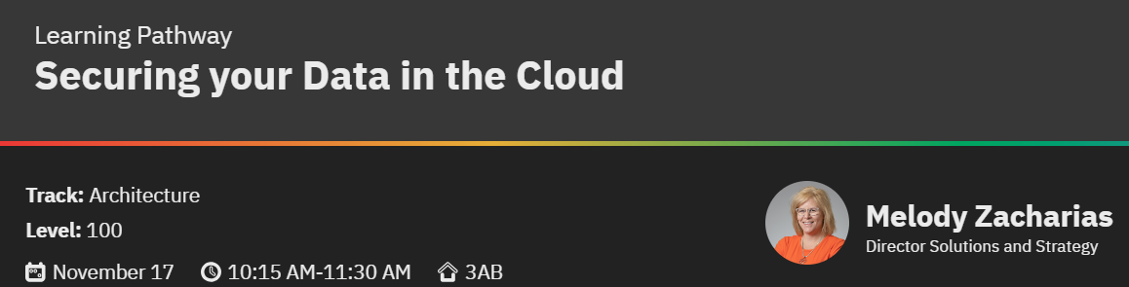

Slide 25
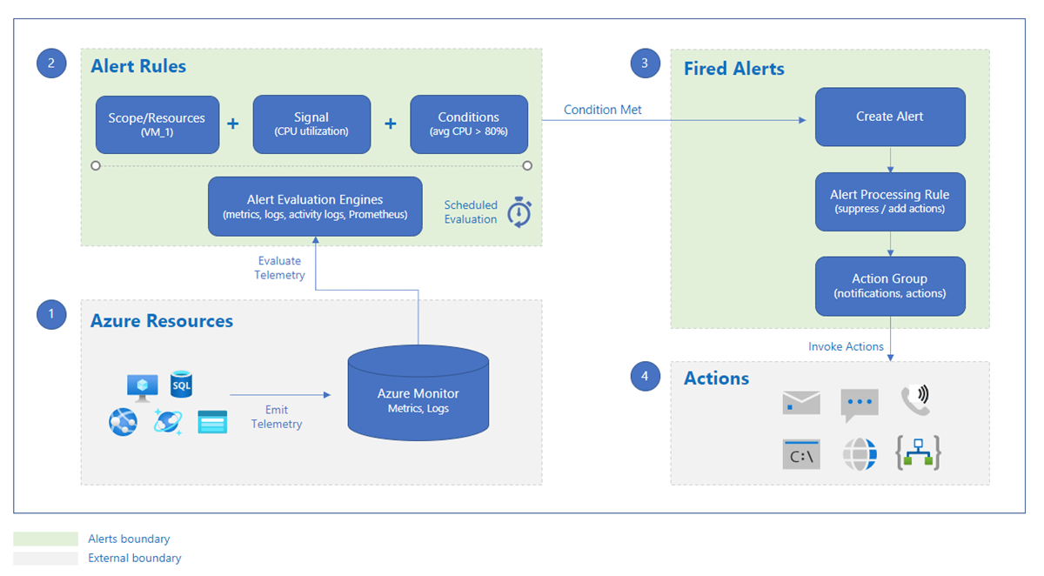
Alerting
https://learn.microsoft.com/en-us/azure/azure-monitor/alerts/alerts-overview
Notes:
An alert rule monitors your data and captures a signal that indicates something is happening on the specified resource. The alert rule captures the signal and checks to see if the signal meets the criteria of the condition.
An alert rule combines:
The resources to be monitored.
The signal or data from the resource.
Conditions.
An alert is triggered if the conditions of the alert rule are met. The alert initiates the associated action group and updates the state of the alert. If you're monitoring more than one resource, the alert rule condition is evaluated separately for each of the resources, and alerts are fired for each resource separately.
Alerts are stored for 30 days and are deleted after the 30-day retention period. You can see all alert instances for all of your Azure resources on the Alerts page in the Azure portal.
Actions
Notification methods, such as email, SMS, and push notifications.
Automation runbooks.
Azure functions.
ITSM incidents.
Logic apps.
Secure webhooks.
Webhooks.
Event hubs.

Slide 26




Alerting
Alerts and Actions
Metrics
Diagnostic Settings
Logs
Notes:
Data can be generated by:
Metrics
Diag setting
Audit
Dmv
Activity log
Knowing what to alert on remain same as what you know today
You have to add few additional things for Azure resources for example: log generation rate, DTU consumption,
How you design this is important. Keep in mind so you can scale out

Slide 27
Alerting
Azure Function
Azure Automation
Azure Data Factory
PowerShell with Scheduler
Elastic Jobs
Alerts and Actions
Notes:
On-Premises we use SQL Server agent for monitoring but in some flavors of SQL in Azure does not have SQL server agent.
These are some of the alternatives you can use to do the same
Few of these also can be triggered via alert action. Such as Azure funcition
Azure automation - notebook

Slide 28

Networking
Connectivity Services
Azure Virtual Network
Azure Virtual Network Manager
ExpressRoute
VPN Gateway
Azure Virtual WAN
Azure DNS
Azure Bastion
Virtual network NAT Gateway
Route Server
Peering Service
Notes:
The networking services in Azure provide various networking capabilities that can be used together or separately. Select any of the following key capabilities to learn more about them:
Connectivity services: Connect Azure resources and on-premises resources using any or a combination of these networking services in Azure - Virtual Network (VNet), Virtual WAN, ExpressRoute, VPN Gateway, Virtual network NAT Gateway, Azure DNS, Peering service, Azure Virtual Network Manager, Route Server, and Azure Bastion.
Application protection services: Protect your applications using any or a combination of these networking services in Azure - Load Balancer, Private Link, DDoS protection, Firewall, Network Security Groups, Web Application Firewall, and Virtual Network Endpoints.
Application delivery services: Deliver applications in the Azure network using any or a combination of these networking services in Azure - Content Delivery Network (CDN), Azure Front Door Service, Traffic Manager, Application Gateway, Internet Analyzer, and Load Balancer.
Network monitoring: Monitor your network resources using any or a combination of these networking services in Azure - Network Watcher, ExpressRoute Monitor, Azure Monitor, or VNet Terminal Access Point (TAP).

Slide 29
Networking
Application protection services
DDoS Protection
Azure Private Link
Azure Firewall
Web Application Firewall
Network security groups
Service endpoints
Application delivery services
Azure Front Door
Traffic Manager
Load Balancer
Application Gateway
Content Delivery Network
Network monitoring services
Azure Network Watcher
Azure Monitor
ExpressRoute Monitor
Network Insights
Notes:
The networking services in Azure provide various networking capabilities that can be used together or separately. Select any of the following key capabilities to learn more about them:
Connectivity services: Connect Azure resources and on-premises resources using any or a combination of these networking services in Azure - Virtual Network (VNet), Virtual WAN, ExpressRoute, VPN Gateway, Virtual network NAT Gateway, Azure DNS, Peering service, Azure Virtual Network Manager, Route Server, and Azure Bastion.
Application protection services: Protect your applications using any or a combination of these networking services in Azure - Load Balancer, Private Link, DDoS protection, Firewall, Network Security Groups, Web Application Firewall, and Virtual Network Endpoints.
Application delivery services: Deliver applications in the Azure network using any or a combination of these networking services in Azure - Content Delivery Network (CDN), Azure Front Door Service, Traffic Manager, Application Gateway, Internet Analyzer, and Load Balancer.
Network monitoring: Monitor your network resources using any or a combination of these networking services in Azure - Network Watcher, ExpressRoute Monitor, Azure Monitor, or VNet Terminal Access Point (TAP).

Slide 30
Networking
Public Access
Connectivity
Public Endpoint: yourservername.database.windows.net
Public network access
Private Access / Endpoints
Virtual networks
Firewall rules
Outbound networking
Connection Policy (cannot change in dedicated SQL pool)
Encryption in transit (Minimum TLS version)
Server-level IP firewall rules
Database-level IP firewall rules
Allow Azure Services and Resources to access this server
Outbound firewall rules
Azure SQL Database
Notes:
In the interest of time what I am talking about is applicable to Azure SQL Database (PaaS) and Azure Synapse Analytics. Not Azure SQL Managed Instance
When you create a logical server from the Azure portal for Azure SQL Database and Azure Synapse Analytics, the result is a public endpoint in the format, yourservername.database.windows.net.
Public Access
Public network access (suggest disabling and using private endpoint).
If you do not want (or you cannot) to disable, You can use the following network access controls to selectively allow access to a database via the public endpoint:
Virtual networks
Allow virtual networks to connect to your resource using service endpoints
Virtual network rules are a firewall security feature that controls whether the server for your databases and elastic pools in Azure SQL Database or for your dedicated SQL pool (formerly SQL DW) databases in Azure Synapse Analytics accepts communications sent from particular subnets in virtual networks.
Firewall Rules
Server vs Database level IP rules- advantage, disadvantage, read, understand, and decide
Allow specific public internet IP addresses to access your resource.
Azure Synapse only supports server-level IP firewall rules. It doesn't support database-level IP firewall rules.
When you create a new server in Azure SQL Database or Azure Synapse Analytics named mysqlserver, a server-level firewall blocks all access to the public endpoint for the server
Allow Azure Services
This option configures the firewall to allow connections from IP addresses allocated to any Azure service or asset, including connections from the subscriptions of other customers.
Switching the setting to ON creates an inbound firewall rule for IP 0.0.0.0 - 0.0.0.0 named AllowAllWindowsAzureIps. The rule can be viewed in your master database sys.firewall_rules view. Use PowerShell or the Azure CLI to create a firewall rule with start and end IP addresses set to 0.0.0.0 if you're not using the portal.
Private Access /Endpoints
A private endpoint is a private IP address within a specific VNet and subnet. effectively bringing the service into your virtual network.
Warning: When you add a private endpoint connection, public routing to your logical server isn't blocked by default. In the Firewall and virtual networks pane, the setting Deny public network access isn't selected by default. To disable public network access, ensure that you select Deny public network access.
Connectivity
Outbound networking
Only resources and applications at the fully-qualified domain names listed below will be allowed to access this server when outbound networking restrictions are enabled. When disabled, the list of domains below will be retained, but restrictions will not apply.
Outbout firewall Rules Outbound firewall rules limit network traffic from the Azure SQL logical server to a customer defined list of Azure Storage accounts and Azure SQL logical servers. Any attempt to access storage accounts or databases not in this list is denied.
Connection Policy Configure how clients communicate with your SQL database server.
Default
Proxy
Redirect is recommended
Encryption in transit
This server supports encrypted connections using Transport Layer Connections (TLS). Any login attempts from clients using a TLS version less than the Minimum TLS Version shall be rejected. For information on TLS version and certificates, refer to connecting with TLS/SSL.

Slide 31
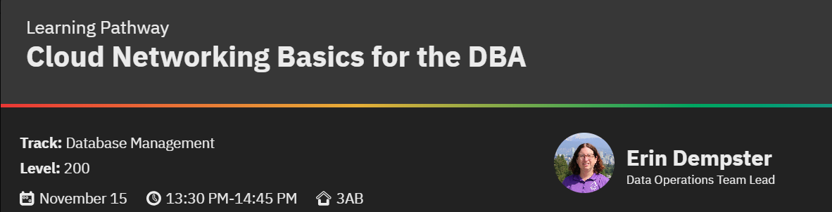

Slide 32



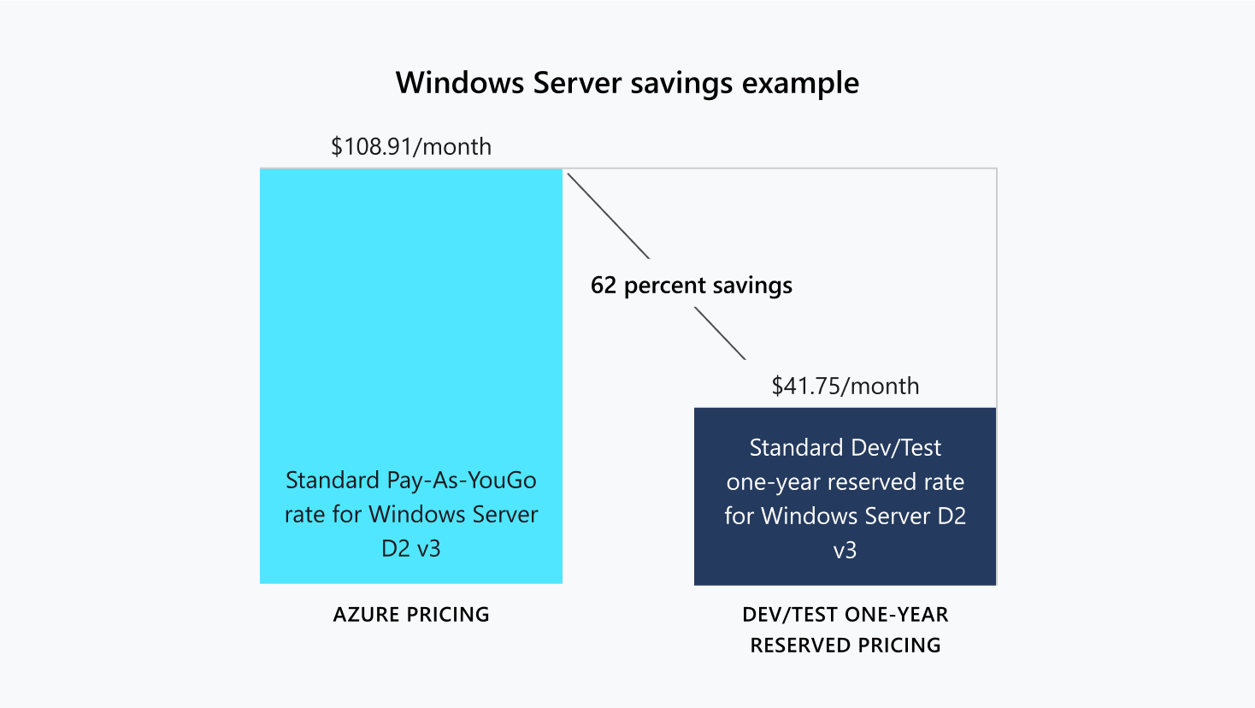

Cost Control
Cost Management And Billing
Azure Reservations
Savings Plans for Compute
Azure Hybrid Benefit
Notes:
This is a new area that you will have to learn.
Going to cloud is not cheap unless you are actively managing cost
Reservations
Azure Reservations help you save money by committing to one-year or three-year plans for multiple products. Committing allows you to get a discount on the resources you use. Reservations can significantly reduce your resource costs by up to 72% from pay-as-you-go prices.
You can use reservations for
Aure sql database
SQL on Azure VM
Azure SQL managed instance
Storage (there are size restrictions)
Savings plans
Azure savings plan for compute is a flexible pricing model. It provides savings up to 65% off pay-as-you-go pricing when you commit to spend a fixed hourly amount on compute services for one or three years.

Slide 33




Cost Control
Dev/Test Pricing
Auto Scale
Elastic Pools
Azure Advisor
Notes:
This is a partial list. My point is be familiar with these capabilities so you can control your cost wisely.
Dev/test pricing: 57% reduction in cost
Use software included in VS subscription for free
Advisor is a personalized cloud consultant that helps you follow best practices to optimize your Azure deployments. It analyzes your resource configuration and usage telemetry and then recommends solutions that can help you improve the cost effectiveness, performance, Reliability (formerly called High availability), and security of your Azure resources.
With Advisor, you can:
Get proactive, actionable, and personalized best practices recommendations.
Improve the performance, security, and reliability of your resources, as you identify opportunities to reduce your overall Azure spend.
Get recommendations with proposed actions inline.

Slide 34

Cost Control
Pricing Calculator
https://azure.microsoft.com/en-us/pricing/calculator/
Azure Hybrid Benefit Savings Calculator
https://azure.microsoft.com/en-us/pricing/hybrid-benefit/
Total Cost of Ownership (TCO) Calculator
https://azure.microsoft.com/en-us/pricing/tco/calculator/
Calculator
Notes:
Use these when business comes and asks you for an estimate because this is official.

Slide 35
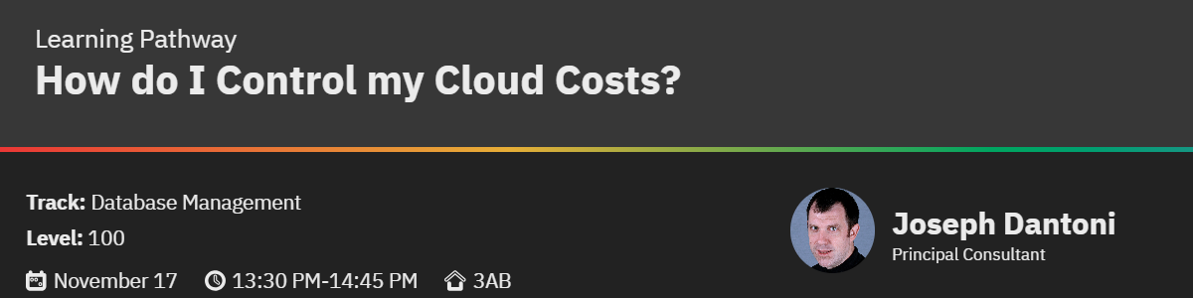

Slide 36
Notes:
Give me honest feedback, please. Do not tell me just you did not like something, please tell me why.
I have been married for over 25 years; I have an awesome wife and three lovely children, so I am ok with raw feedback.

Slide 37
Attend other sessions of this Learning Pathway
Taiob Ali
@sqlworldwide
Taiob@sqlworldwide.com
www.sqlworldwide.com

